Slide 1

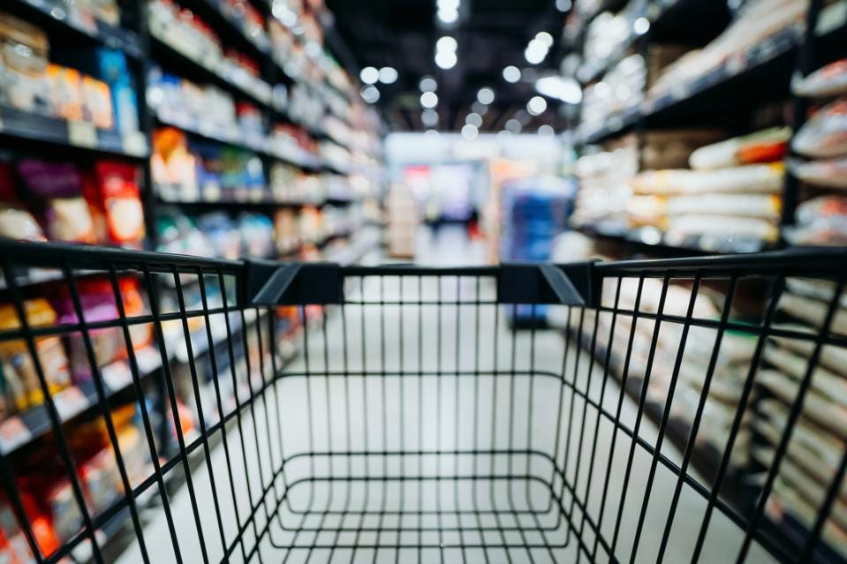
Data Science
- Retail Forecasting
February 28th, 2023
Hina Timothy, Junfei Liu, Siming Luo
Notes:
Picture: https://www.forbes.com/sites/forbesbusinessdevelopmentcouncil/2021/02/02/lessons-and-predictions-for-retail-industry-post-2020/?sh=691f93634d78

Slide 2
Agenda
Introduction
Exploratory Data Analysis
Forecasting Models
Forecasting Results
Conclusions

Slide 3
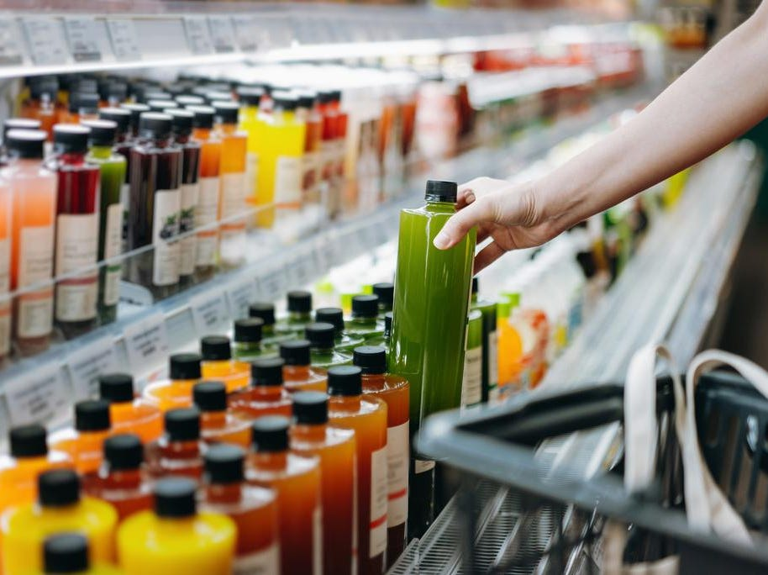
Introduction
Beverage Industry Highlights
Market volume, from 696.1 Liters to 994.1 (2009 to 2018)
PepsiCo, 342 new non-alcoholic beverage (January 2016 and February 2021)
Anheuser-Busch InBev, global learning company with over 54 million U.S. dollars sales
Problem Statement
An Australian company which has beverage business has needs to forecast sales for each product. The company already has a in-house solution for predicting sales. However, they want to seek solutions based on AI/ML.
Challenges
unpredictability of consumer behavior
economy, weather, and social trends
the rise of e-commerce and online retail

Slide 4
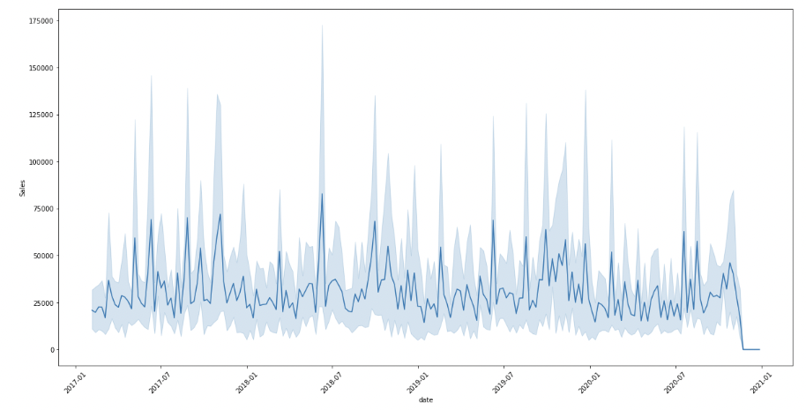
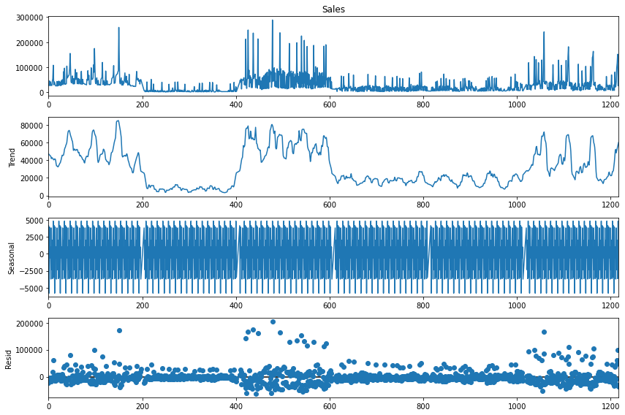
Exploratory Data Analysis
Sales overtime
Decomposition of Sales (Trend, Seasonality, Residuals)
By checking how sales perform overtime, it is evident that seasonality exists
Further decomposition shows that there is a non-linear and additive trend with seasonality
The series is stationary as no pattern appears in the residual plot

Slide 5
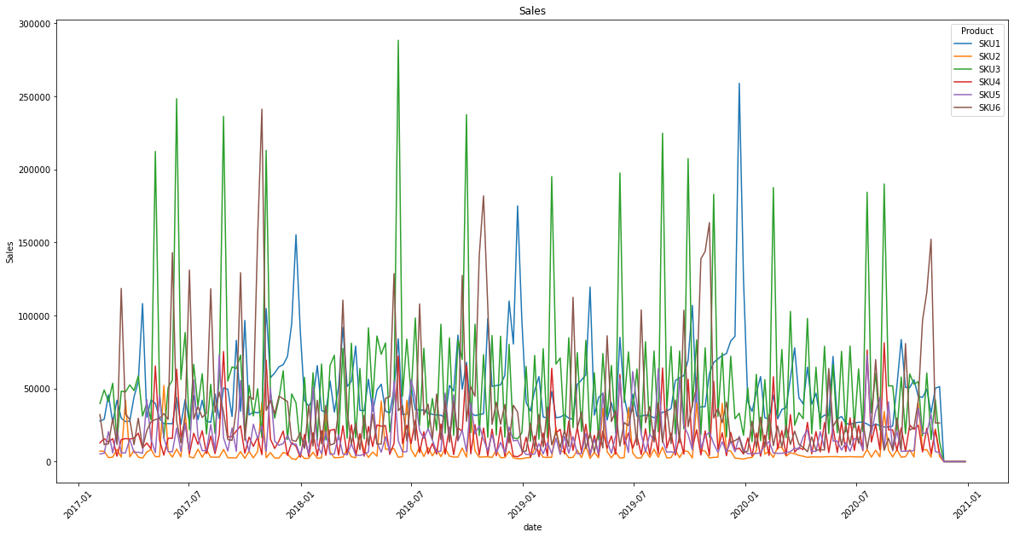
Exploratory Data Analysis
Here we first demonstrate the overall distribution of sales over time.

Slide 6
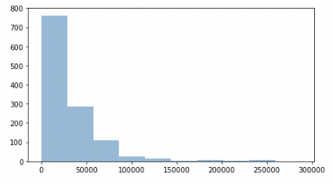
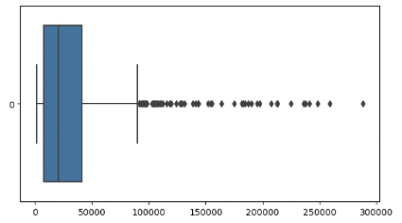
Exploratory Data Analysis
Sales data is right skewed and has a lot of outliers
Three ways to handle outliers
90% capping
Log Transformation
Normalization

Slide 7
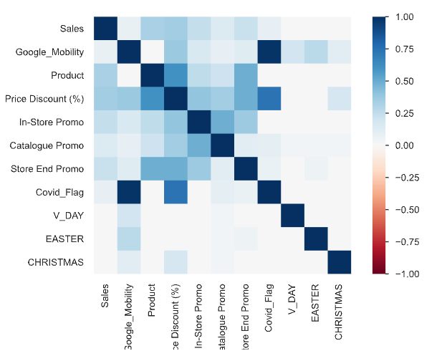
Exploratory Data Analysis
Discover the correlation:
Besides the last three features, Sales has positive correlation with all other features to different extents.
The noticeable correlations:
Sales with Price Discount (%) - 0.347978
Product with Price Discount (%) - 0.603060
Covid_Flag with Price Discount (%) - 0.734857
Covid_Flag with Google Mobility - 0.982582

Slide 8
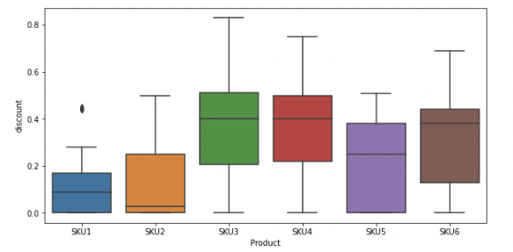
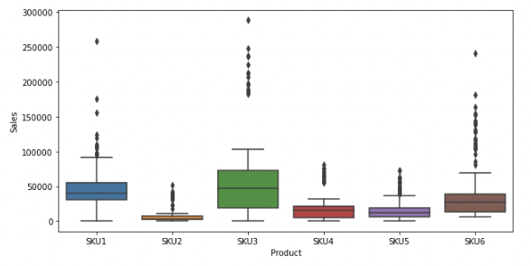
Exploratory Data Analysis
From sales by product boxplot, SKU3 is the product that performs relatively better
SKU6 and SKU3 are products which have higher sales because of heavy discount
SKU1 is the product that rarely has discount but still incur high sales
Overall, the company should focus on producing SKU1, SKU3, SKU6

Slide 9
Forecasting Models
SARIMA
RNN
LSTM
Take into account both seasonality and trends in the data
Recurrent Neural Networks (RNNs) are particularly useful for forecasting complex patterns and trends in sales data for the products
Long short-term memory networks is capable of learning long-term dependencies, particularly in sequence prediction problems
Linear Regression
Simple Naive (Baseline)
Holt-Winter’s Seasonal Method
GRU
Identify the key drivers of sales, such as price, promotions, seasonality, and marketing campaigns
A basic method that involves assuming that future sales will be the same as past sales
Involves estimating three parameters: the level of sales, the trend in sales, and the seasonal component of sales
Gaing Recurrent Units,
a gating mechanism in recurrent neural networks

Slide 10
Forecasting Results
Products | Linear Regression | Simple Naive | SARIMA | RNN | LSTM | GRU | Holt-Winter’s Seasonal
SKU1 | 0.79 | 0.97 | 0.97 | 0.73 | 0.87 | 0.85 | 0.97
SKU2 | 0.21 | 0.92 | 0.94 |  |  |  | 0.97
SKU3 | 0.35 | 0.91 | 0.97 |  |  |  | 0.95
SKU4 | 0.34 | 0.88 | 0.97 |  |  |  | 0.94
SKU5 | 0.65 | 0.94 | 0.94 |  |  |  | 0.93
SKU6 | 0.17 | 0.92 | 0.93 |  |  |  | 0.96

Slide 11
Conclusion
Recommendations
To increase forecasting accuracy, it is suggested that the company should do log transformation on its sales.
To maximum the sales amount, the company should focus on producing SKU1, SKU3, and SKU6.
The best model for the company’s case is SARIMA with log-transformed sales. SARIMA model is widely used in the retail industry.
Concerns and Future work
The best model has a high accuracy rate which may incur overfitting problem. We need more data to validate the results.
The company should adjust the parameters if necessary.

Slide 12
Thank You

